Slide 1
Huawei IP Network Products Sales Training --2020.5

Slide 2
IP Products Sales Strategy Overview
Campus Switches
Campus WLAN Products
Data Center Switches
Edge Routing: AR G3 Products
Core Routing: NE Products
Security Products

Slide 3
Unified VRP Platform
Switch
Router
WLAN
Security
Access
VRP
Centralized
V1
V8
Multi-process, multi-core
Distributed
V3
V5
Single-process, single-core
19+ years
8 million+
100+
22 million+
development
devices
countries
lines of code

Slide 4

Standards and Patents
Huawei ranks No. 2 in the industry in terms of the number of IETF drafts and authors.
IETF (Authors/Documents) As of June 2019.12
Source: http://www.arkko.com/tools/allstats/companies.html

Slide 5

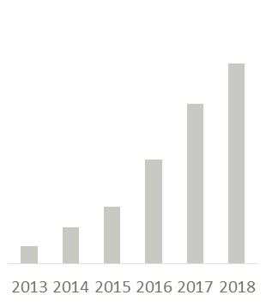

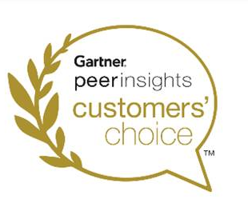


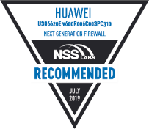


Awards and Certifications
Data center network
WLAN
SD-WAN
82%
Accumulated CAGR
65%+
Revenue CAGR
25%+
Revenue CAGR
Gartner peerinsights Customer’s Choice 2019 @ CloudFabric
Interop 2019 @Routers
Interop 2019 @Wi-Fi 6
Interop 2019 @CampusInsight
Source: IDC, 2018
Source: IDC, 2018
Source: IDC, 2018
Ethernet switches
SDN Controller
Routers
Ranking in the global market
Ranking in the global market
Best AI/ML application award
Positioned as a Challenger
for WAN Edge Infrastructure
2019 NSS Lab @HisecEngine
（SDN/NFV World Congress）
No.1
No.2
No.2 in the global market
（DC & Enterprise）
8-year consecutive growth of Huawei router business– unique in the industry.
1/3 of global backbone traffic bear by Huawei IP core routers.
700 million hours stable operation accumulatively.
Source: IDC, 2018
Source: IDC, 2018
Source: IHS, 2018H1

Slide 6














Go-To-Market Model: A 100% Indirect Channel Model
Authorized Reseller
Public Sector
Distributor
Gold
Partner
Silver
Partner
Authorized
Partner
WAN
Wi-Fi
Large Enterprise
Enterprise IP Networking
VAP
Finance
Datacom
Security
Wireless
Energy & Power
Carrier Resale Partner
Transportation
Global Partner
SME
Security
Security
Network

Slide 7




Key IP Product Sales Opportunities
Product Lifecycle EOL/EOW
Opportunity to upgrade/migrate existing competitors‘ IP products to Huawei IP products
EOL – End of Life
EOW – End of Warranty
Two-Vendor Strategy
Key benefits of Two-Vendor Strategy to enterprise customers are:
Standardized infrastructure – simplifies OAM
Cost-saving & investment protection
Eliminating vendor lock-in
“Gartner concluded that a multi-vendor strategy results in costs savings of roughly 15% to 25% over a period of five years" (Forbes.com by Trefis Team)
Greenfield
Operational Restructuring & Consolidation
Often includes a network refresh:
Consolidation
Expansion
Re-organization
New Platform Rollout
Both new services and new service units:
Application evolution
Computing evolution
Mobility evolution
Storage evolution

Slide 8
Channel Service GTM
Customers
Partner
Huawei Brand Services
Resold by partners
Delivered by Huawei
Partner Brand Services
Sold and delivered by CSP
Supported by Huawei
HiCare
CoCare
Huawei Service Platform
Support-E/E-Learning/Simulators/TACs/Spares
Always Online
CSP: Certified Service Partner

Slide 9






Why Huawei IP Products?
Standardization & Open Architecture
Easy third-party integration and good interoperability
Leading in industry standards & patents
Future-oriented Performance
Future-proof solutions
Investment protection
Enabling flexibility & resiliency on the
infrastructure for expansion and growth
High-Quality Cost-Effective Products
19+ years of R&D experience in IP technologies
Industry-leading IP chipsets and IP OS
Wide portfolio of enterprise ICT products, building E2E customer-centric networks
Distributed Global R&D Capability
R&D and technical support team-closer proximity to customers
Global supplier with focus on markets outside the home country
A Better Way
Customer-centric IP Network Solutions
10GE fast and flexible campus networks; mobile campus networks with highly available WLAN services; green, energy-efficient campus networks
Service Continuity Data Center Solution
One-Stop Branch Access Solution

Slide 10
IP Products Sales Strategy Overview
Campus Switches
Campus WLAN Products
Data Center Switches
Edge Routing: AR G3 Products
Core Routing: NE Products
Security Products

Slide 11
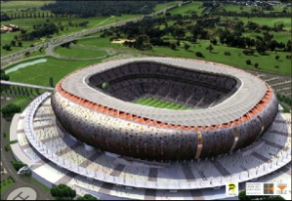


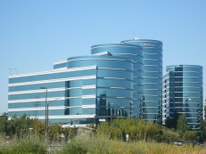
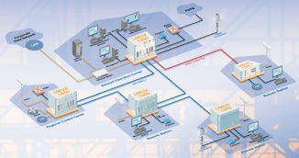




S Series Switches: Sales Opportunities & Strategies
Government:
e-Government: Government platform to support efficient office
Video surveillance network
Sports stadium: Large events
Airport/Sea port: Airport/seaport network infrastructure replacement and upgrade
Hospital:
E-health: Hospital network infrastructure, remote hospital, hospital metro network (delivered in Ghana)
Education:
Higher education:
Digital campus, network access
of teachers’ and students’ devices
General education: Education network infrastructure replacement and upgrade; HD video surveillance network
Large Enterprise:
Enterprise office networks: BYOD, mobile office, EDC, desktop cloud
Opportunity
ISP:
ISP Metro Ethernet: Bandwidth wholesalers to build cost-effective metro networks and data centers
Others:
Office networks in vertical industries: BYOD to promote efficiency
Media:
Office and production network:
HD video requires network infrastructure upgrade.
Commercial distribution
SOHO&SMB: choose part of the best-selling models in S2700/S3700/S5700.
Focus on NAs: Match the NAs of the Enterprise BG based on the value areas & industries of switches, and then
select the value customers.
Markets outside China: Focus on main scenarios: government, hospital, education, large enterprise, etc.
Campus network: Focus on modular switches, which determine the market structure.
Solution replication: Elaborate solutions based on the projects, guide the region & office, and achieve reciprocal benefits.
Strategy

Slide 12



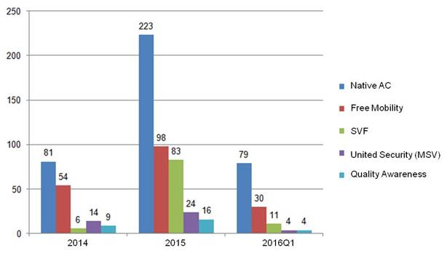
S Series Switches: Key Selling Points
SDN Architecture, Ability to Support New Services
Template-based network design and automatic service deployment, reducing the OPEX
Big Data-based visualized and intelligent O&M, providing quantitative data for decision-making
Free mobility and on-demand resource migration, ensuring consistent user experience
BYOD
Cloud application
SDN
Convergent network
Real-time and secure
Programmable
Rich Agile Functions to Improve User Experience and Simplify O&M
Automation Capabilities: Campus switches provide NETCONF/YANG capabilities. They are also VXLAN capable to implement network virtualization. The switches support policy automation, achieving end-to-end network deployment and reducing network O&M.
Intelligence Capabilities: Campus switches support streaming telemetry to collect network data in seconds. They use Enhanced Media Delivery Index (eMDI) to detect audio and video quality. The result is intelligent O&M of wired and wireless networks.
Integrated Security Capabilities: Campus switches implement Encrypted Communication Analytics (ECA) and proactive threat deception through built-in security probes. These features promote collaborative campus-security protection and help prevent the lateral movement of threats across networks.
Function | Sub-function | Interconnection with Cisco Devices | Replacement with Cisco Devices
Authentication | PAP/CHAP | Y | Y
 | EAP-MD5 | Y | Y
 | EAP-TLS | Y | Y
Authorization – Access | Wired MAC authentication | Y | Y
 | Wired DOT1X authentication | Y | Y
 | Wireless MAC authentication | Y | Y
RADIUS | RADIUS attributes | Y | Y
BYOD | Bring Your Own Device | N | Y
Standards Compliance, Interoperability with Other Vendors
Forwarding interoperability: S series switches are developed in compliance with international standard protocols. Miercom and Tolly have proved the outstanding interoperability capabilities of Huawei’s S series switches.
Authentication interoperability: Except the proprietary attributes, Huawei and Cisco devices are interoperable; Huawei’s interoperability capabilities are equivalent to HP and Aruba.
Terminal interoperability: Using Huawei-recommended terminal discovery protocols, Cisco and Avaya phones are interoperable.

Slide 13
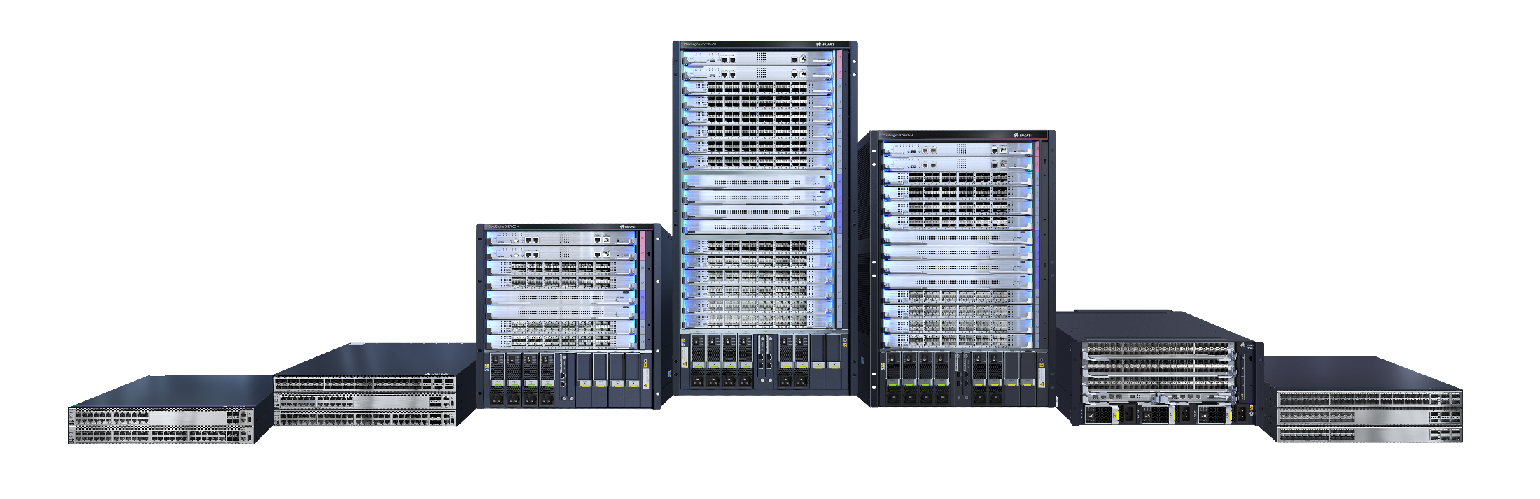

CloudEngine S Series Switches: Building a High-Quality Campus Network for the Wi-Fi 6 Era
CloudEngine S12700E-12
CloudEngine S12700E-8
CloudEngine S12700E-4
CloudEngine S7700
CloudEngine S5730-H/S
CloudEngine S6730-H/S
CloudEngine S5735-S/L
Wi-Fi 6 Ready
IoT Ready
Cloud Ready
Quality Ready
Core switches deliver 6x the industry switching performance
Innovative hybrid optical-electrical switches build ultra-high-speed Wi-Fi 6 networks
Integrated WAC (or native AC) provides ultra-large specifications
Intelligent terminal identification facilitates refined access control of IoT terminals at scale
Cloud-based management and O&M, when combined with iMaster NCE, achieves automatic deployment and intelligent O&M
HQoS ensures the application experience for key users.
Fully programmable, open architecture facilitates smooth network evolution

Slide 14
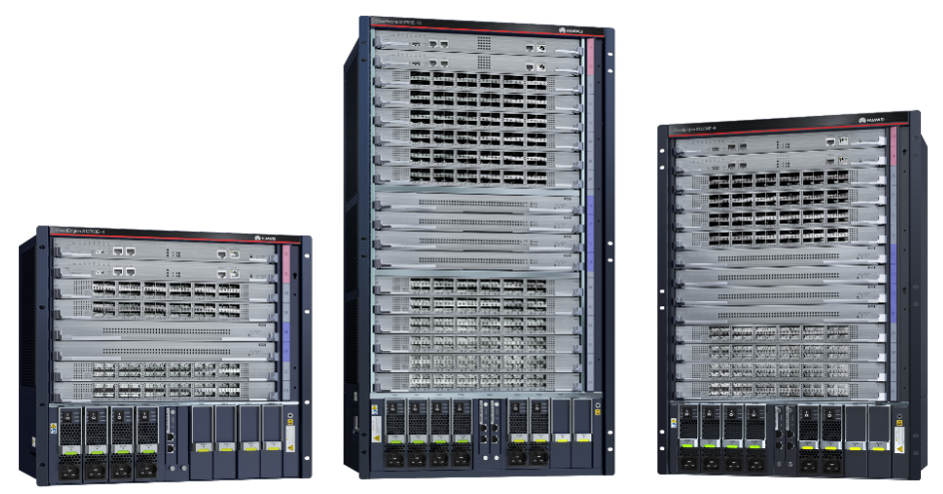

CloudEngine S12700E: The new core of the campus network in the era of Wi-Fi 6
CloudEngine S12700E-4/8/12
Control and switching separation architecture, enabling on-demand configuration and flexible capacity expansion
Redundancy design for key components, providing 99.999% reliability
Ultra-large buffer and HQoS scheduling, ensuring user experience with key applications
4.8 Tbps/slot super-strong forwarding, building a Wi-Fi 6 high-speed channel
Benchmarking Model
HW:S12700E | CISCO:C9600
Next-Generation High-Performance Campus Core Switches Unleash Wi-Fi 6 High-Speed Potential

Slide 15


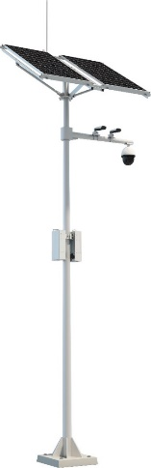



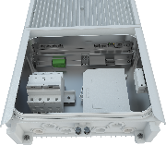

CloudEngine S5735-S-IA: Next-generation Video Backhaul Switch
High reliability
Operating temperature: –40°C to +55°C
IP55, anti-salt spray, 6 kV surge protection
Natural heat dissipation without fans, maintenance-free for 5 years
Easy deployment
Integrated design, requiring no internal connections
Installation completed by a single person within 20 minutes, reducing onsite installation workload by 80%
12 V DC, 24 V/220 V AC, and PoE
Protective shell
Fiber splice tray
Surge protector
AC/DC power supply
High security
Pan Tilt and Zoom (PTZ) dome camera linked when an alarm is generated upon unauthorized device opening
IPC identification, preventing unauthorized access or replacement
Integrated design
Easy O&M
IPC topology discovery and offline diagnosis*
Industry-unique eMDI for intelligent diagnosis of audio and video services
Switch
PoE+
SmartX

Slide 16
CloudEngine S-series Switch Evolution Path
S12704/08/12
CloudEngine S12700E-4/8/12
X5/X6
Modular
S7703/06/12
S7700 MCU：MCUD/SRUHX1
X5/X6
S6720-HI/EI
CloudEngine S6730-H
Fixed
(10GE)
S6720-SI
CloudEngine S6730-S
S6720-LI
CloudEngine S5732-H(Multi-GE)
S5730-HI
CloudEngine S5732-H
S5720-HI/EI
CloudEngine S5731-H
S5730-SI
CloudEngine S5731-S
Fixed
(GE)
S5720-SI
CloudEngine S5735-S
S5720I-SI
Video Backhaul Switch
CloudEngine S5735-S-IA
S5720I-SI
Extended-Temperature Switch
CloudEngine S5735-S-I(24 Port)
S5720-LI
CloudEngine S5735-L

Slide 17
IP Products Sales Strategy Overview
Campus Switches
Campus WLAN Products
Data Center Switches
Edge Routing: AR G3 Products
Core Routing: NE Products
Security Products

Slide 18
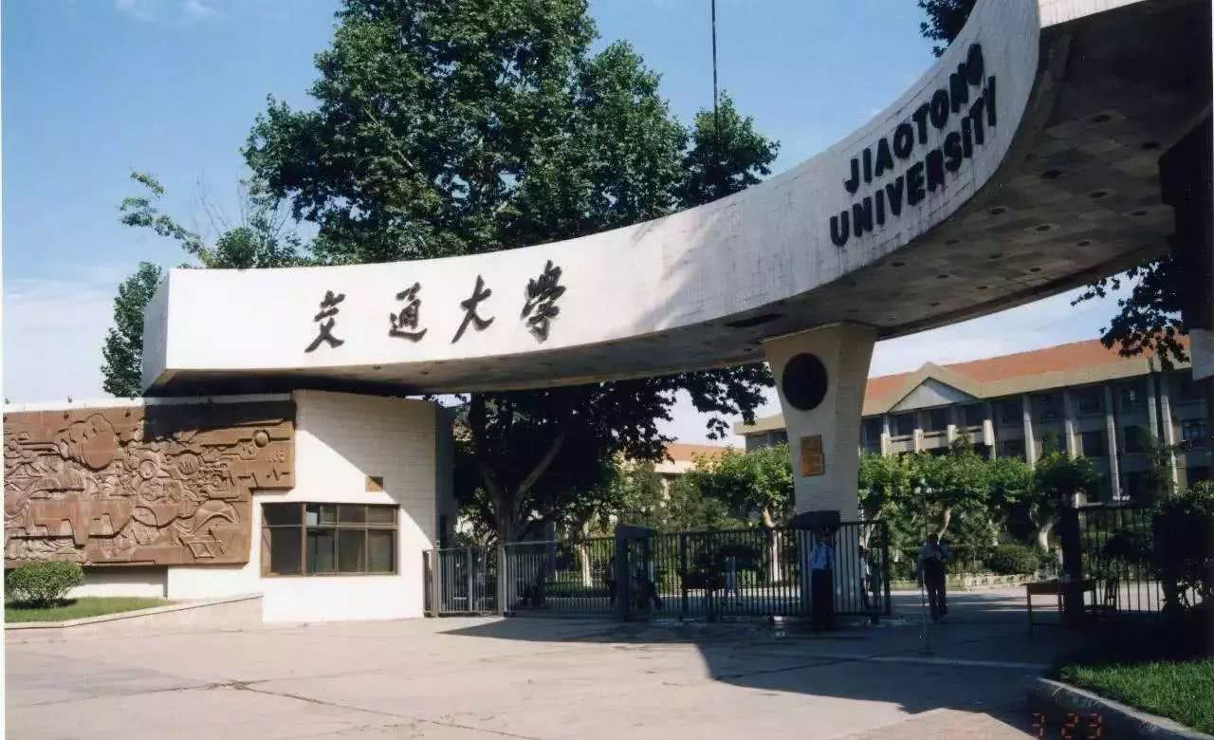


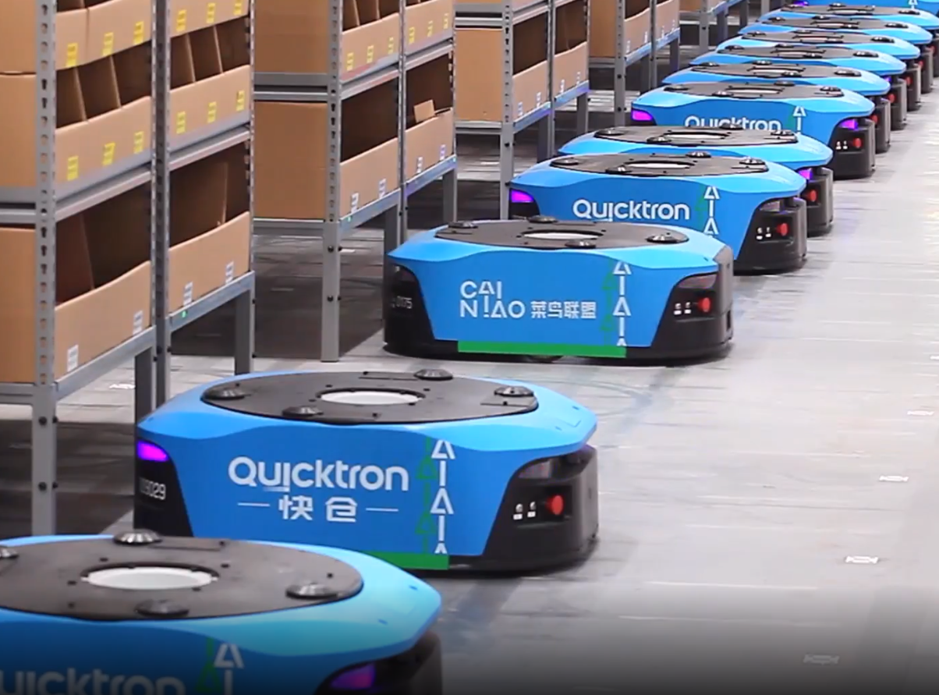








Wireless: A Solid Foundation for Enterprises' Digital Transformation
Higher Education, Primary/Secondary Education
Large Enterprise
Retail/Shopping Mall/Supermarket
Production and Manufacturing
Mass Branches
Public Services
Wired-to-wireless upgrade
AR/VR teaching
Wireless multimedia teaching
All-wireless office
Wireless campus
WeLink for wireless office
ESL (wireless)
Wireless mobile cashier
Self-service checkout machine
Wireless scale
Automated production
AGV (wireless)
Asset management
HD quality inspection
Massive branch management
Remote O&M
Public Wi-Fi
MISE wireless city
Xi'an Jiaotong University
Ping An Technology
Italy MISE
AR/VR: improves students' learning efficiency by 76%.
By 2024, 75% of conferences will be held remotely.
(Currently, only 40% of conferences are held remotely.)
— Gartner
Millions of robots are deployed in commercial scenarios, including hundreds of thousands of robots that start to provide professional services.
— Deloitte
By 2024, the compound annual growth rate (CAGR) of the urban hotspot market space in public areas will exceed 12%.
— Global Market Insights

Slide 19
Traditional Wi-Fi 4 and Wi-Fi 5 Networks Are Confronting New Challenges of Enterprises' Digital Services
VR/AR
4K smart camera
ESL
Factory AGV
Energy efficiency management
Enterprise apps onto the cloud
IoT
IoT
Wireless
IoT
Wireless
Cloud-based
1
2
3
10-fold increase in bandwidth requirements How to ensure 100 Mbit/s bandwidth for each user at any location?
High reliability of mobile production activities
How to ensure an ultra-low latency of less than 10 ms during production movement?
Experience assurance in the case of environment changes
How to provide committed high-quality experience in an ever-changing environment?

Slide 20
Huawei Wi-Fi 6 Changes Enterprises Highly Reliable Enterprise Office and Production Networks + Cloud-Based Intelligent O&M + Multi-Protocol IoT Convergence
Now | Future | Customer Benefits
Best-effort enterprise office network | Guaranteed enterprise office and production network Large capacity, high reliability, and low latency | 10GE or higher APs, multi-carrier (2 to 4 carriers), ultra-broadband (20/40/80/160/320 MHz), and MSC7 for valid coverage enhancement Ultra-fast ultra-broadband WAC and QoS, delivering per-user and per-application assurance across the full process from AP management to user experience guarantee High reliability, low latency, anti-interference, and seamless roaming, maximally supporting the production network E2E security, flexible configuration of internal and external networks, and air interface security
Complex deployment and passive response | Intelligent and simplified WLAN that features self-optimization and self-management Intelligent O&M | Autonomous driving network, adaptive to scenarios and terminals, automatic network planning and optimization, network health self-check, automatic fault locating, and basic self-healing capabilities Easy management: intelligent upgrade, lossless service upgrade, and wide version compatibility
People-people connections | Diversified massive connections for people and things Multi-protocol IoT convergence for more value-added services | Multi-protocol IoT convergence technology, scalable software and hardware platforms Multi-protocol air interface interference detection and coordination

Slide 21


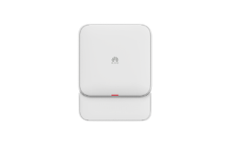



Industry's First Full Series of Wi-Fi 6 Products, Ideal for Build Future-proof High-quality Wi-Fi
Ultra-broadband access and ultra-high-speed experience
Built-in smart antenna, improving signal quality by 100%
4X increase in concurrent users, from 100 to 400 (compared with Wi-Fi 5)
4X increase in per-user bandwidth, from 2 Mbps to 6 Mbps (compared with Wi-Fi 5)
Asset management
VR application
Stadium service
Industry-unique SmartRadio technology
Lossless intelligent roaming, with zero packet loss for services
30% higher performance through DFA and DBS
Voice and VR service latency reduced to less than 10 ms, due to an application acceleration engine
Flexible expansion into IoT applications
Wi-Fi and IoT converged architecture, reducing the TCO of the entire network by 50%
Built-in Bluetooth 5.0, supporting extended applications such as Bluetooth serial port and Bluetooth location
Connected people and IoT terminals
100 Mbps/person, latency < 15 ms
400+ concurrent users per AP
SmartRadio: Supported on Huawei 802.11ac Wave 1 and later APs
Office IoT
VR class/game
High-density stadium

Slide 22

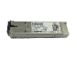
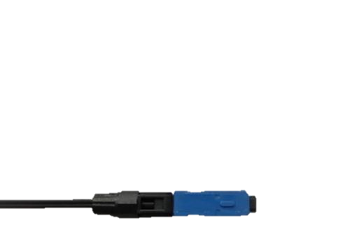
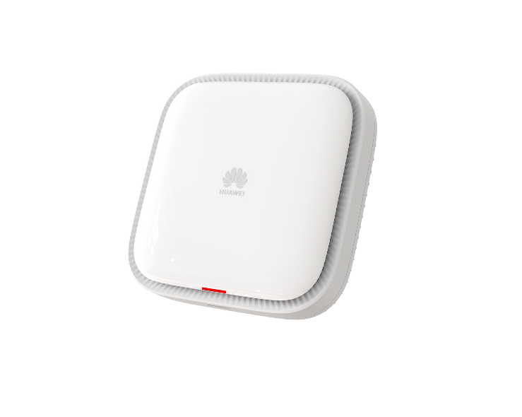
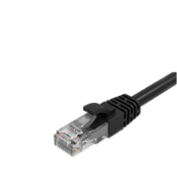

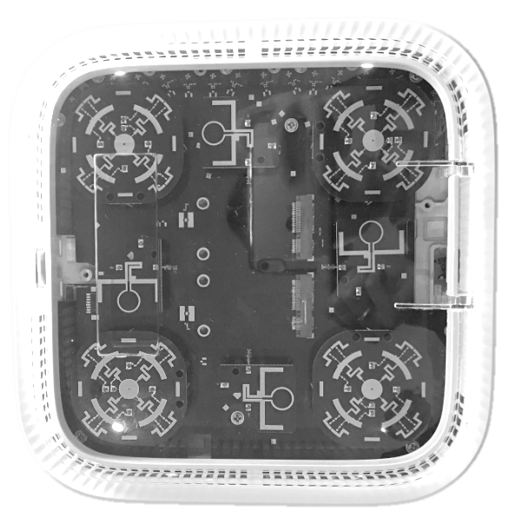

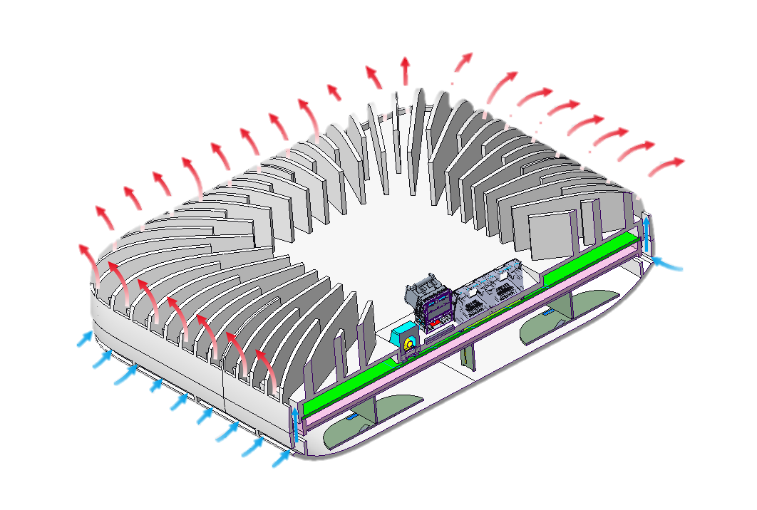
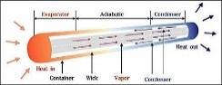
Flagship Indoor Wi-Fi AP: AirEngine 8760-X1-PRO
16 spatial streams + flexible radio mode switchover
Two 10G uplink ports
16 spatial streams
Ultra-high capacity
10.75 Gbps
10GE
10GE
Optical: 10GE SFP+
Electrical: 10GE x 2
Supporting optical/electrical hybrid cable
Radio modes: 4+8+independent radio for scanning/4+12 / 4+8+4
Dual-PoE power supply, improving AP reliability
Independent probe
Micro air ducts + liquid cooling
AirEngine 8760-X1-PRO
* Works with CampusInsight to perform big data optimization.
Micro air duct-combined heat dissipation system
Independent hardware + dual-band scanning
Real-time network optimization
Liquid cooling
4 degrees
Parameter | Specification | Parameter | Specification
Port | 2 x 10GE electrical + 1 x 10GE SFP+ | Antenna | Built-in smart antenna
Bluetooth | Bluetooth 5.0 | Power supply | DC: 42.5 V to 57 V PoE++, dual power supplies for backup
AP rate | 1.15 Gbps + 9.6 Gbps | USB port | 1
Built-in IoT module | ZigBee, RFID, asset management, and ESL | Security | Hardware encryption: IPsec and DTLS WPA3

Slide 23
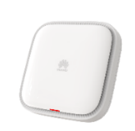



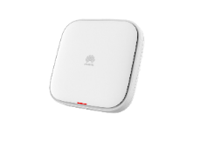
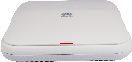
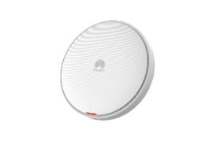

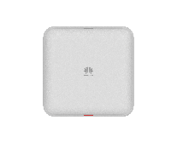
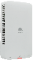
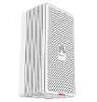
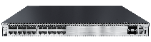
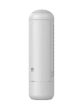
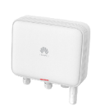
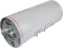
2020: Sustainable Supply of Wi-Fi 5 Products and Launch of New Diverse-Supply Wi-Fi 6 Products for All Scenarios
Sustainable supply of Wi-Fi 5 and Wi-Fi 6
Full-series Wi-Fi 6 to be launched in 2020 Q1
Flagship model
AP7000 series
AP7060DN
AirEngine 8760-X1-PRO
4+12, 4+4+8, or 4+8+scanning
AP6000 series
AirEngine 6760 series
RTU upgrade: 4+4+4, 4+8, or 4+6+scanning
Basic: 4+6
Mid-range and high-end models
Economical model
AP4000 series
AirEngine 5760-10
AirEngine 5760-51
RTU upgrade: 2+2+4, 4+4, or 2+4+scanning
Basic: 2+4
Wall plate model
AP2000 series
AirEngine 5760-22W
2+4
Agile distributed model
AD9400/R200 series
AirEngine 9700D-M/5760-22WD
2+4
+
+
Outdoor model
AP8000 series
AirEngine 8760R series
8+8, 4+12, 4+4+4, or 4+8+scanning
AirEngine 6760R series
4+4

Slide 24
IP Products Sales Strategy Overview
Campus Switches
Campus WLAN Products
Data Center Switches
Edge Routing: AR G3 Products
Core Routing: NE Products
Security Products

Slide 25
Data Center Switches: Sales Opportunities & Strategies
Government:
E-Gov: e-government platform, national data centers
Education:
Higher education: university campus + data center platform, regional education platform, HPC
Health:
Electronic health information network: hospital telemedicine, medical imaging
Large Enterprise:
EDC: large enterprise ERP, PRM, OA, such as efficient systems and DC cloudification
ISP:
ISP/OTT: Internet company opportunity
CoLo DC: colocation data center, physical server, VM/VPC leasing
Opportunity
Energy:
Production networks: oil, energy, and electricity DC network, including HPC for mining
Carrier:
Rack hosting, carrier EDC, telecom cloud
Finance:
Geo-redundant financial centers: financial data center
Key NAs: Match the value of the industry's enterprise BG NAs and filter out key NAs according to the value regional data center switches.
Markets outside China: Focus on customer ISP/OTT, colocation DC, carrier, finance, and education industries, make breakthroughs to establish a foothold in the market, and nurture other opportunities.
Solution replication: Guide projects before bidding and build a virtuous cycle through project operation and detailed solutions.
Strategy

Slide 26


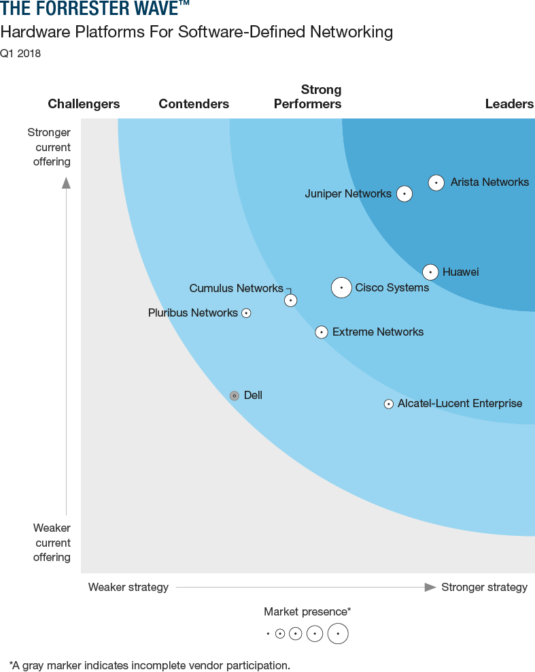

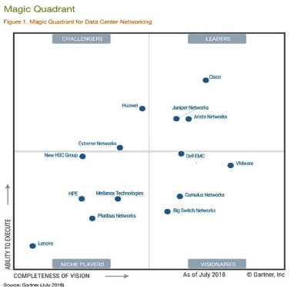

CloudEngine Series Switches Serve 7800+ Global Customers
The market share is No.1 in China and No.3 in the world.
The global market share growth rate is No. 1 for four consecutive years.
Over 32,000 CE12800 switches have been sold around the world, serving 7800+ customers in 120+ countries.
2018 Approaching the Leaders Quadrant
2017 Challenger
DC SDN
SDN hardware platform leader
Gartner Peer Insights
Customers’ Choice
for Data Center Networking

Slide 27





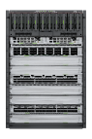

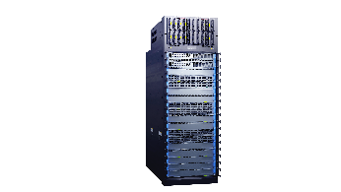




Huawei CloudFabric DCN Solution Overview
Application layer
Huawei CloudEngine:
Gartner Peer Insights Customers' Choice distinctions twice
Finance
Internet
Large enterprise
Government
Cloud platform layer/Management and control layer
Intelligent
High SDN deployment efficiency
1-3-5 intelligent O&M
vCenter
Virtual management platform
Huawei CloudStack
* 1-3-5: A fault is discovered within 1 minute, located within 3 minutes, and rectified within 5 minutes.
Autonomous driving network
Embedded AI chip + innovative iLossless algorithm
Ethernet with zero packet loss, 30% computing power
Fabric network
Ultra-broadband
CloudEngine 16800
Lossless
CloudEngine 16800
DCN switch with large capacity
High density
Gartner Peer Insights Customers' Choice distinctions twice
VM
Container
BM
Ethernet with zero packet loss
VM
Server
VM
VM

Slide 28
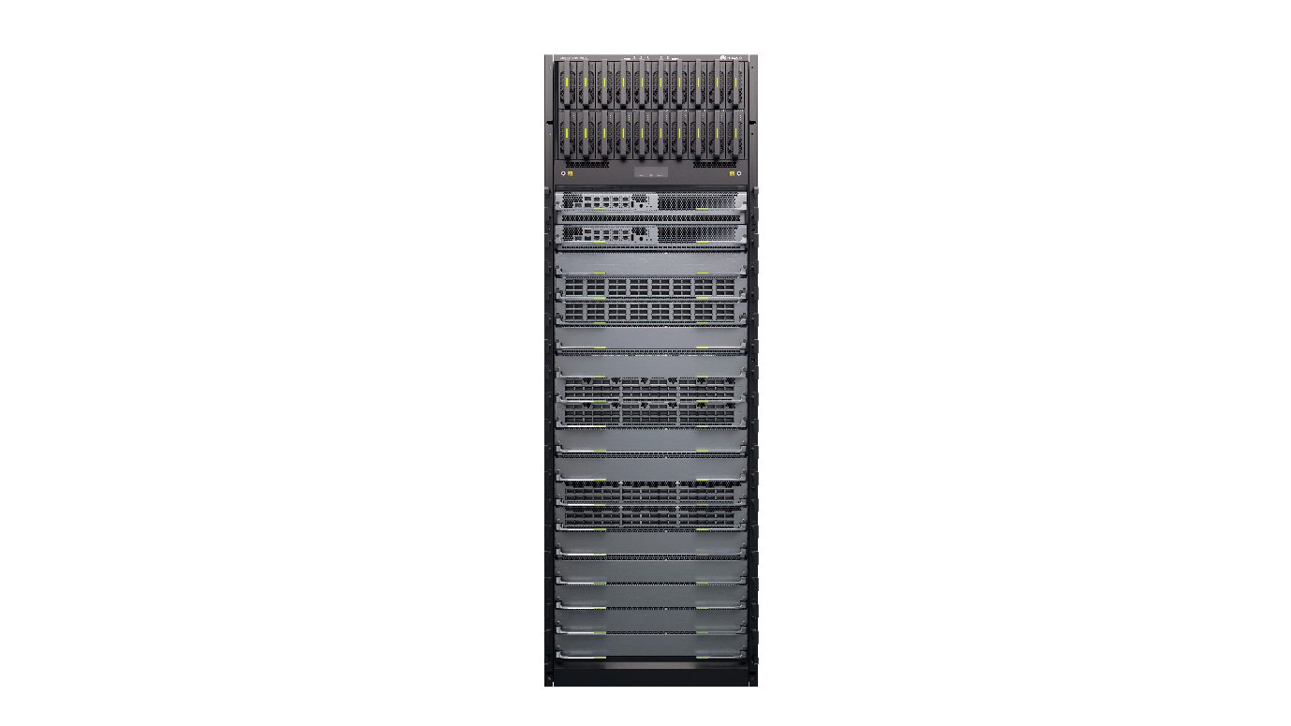
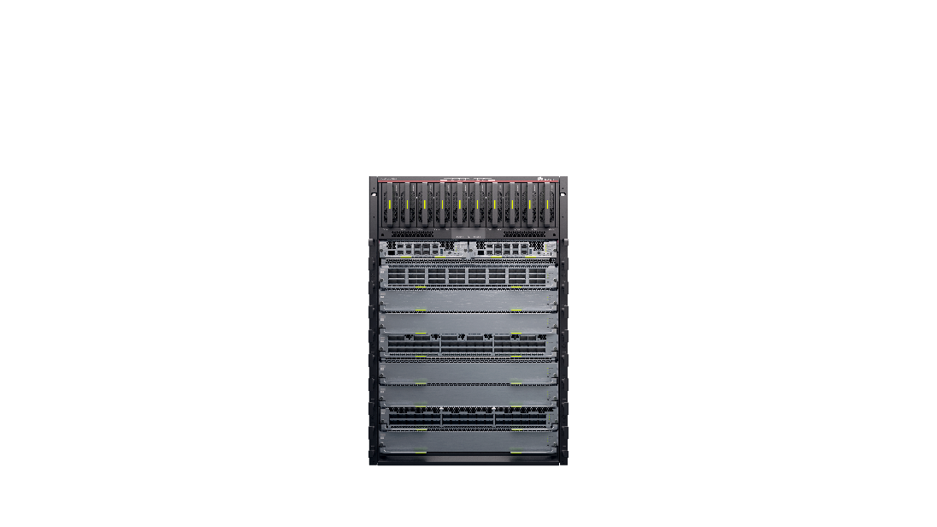
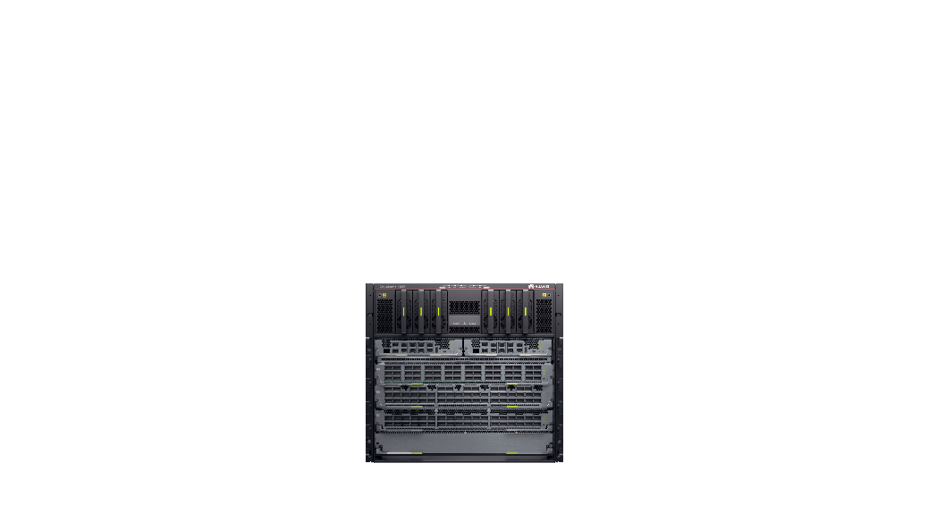
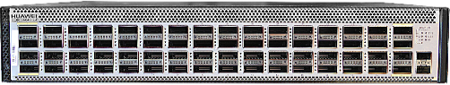
Portfolio of CloudEngine Series Switches (Mainstream Models)
Core switches
Access switches
10GE TOR switch
CloudEngine 16800
CloudEngine 6820-48S6CQ
(VXLAN not supported)
10GE TOR switch
CloudEngine 6881-48S6CQ
10GE + 25GE TOR switch
CloudEngine 6881E-48S6CQ
25GE TOR switch
CloudEngine 6863-48S6CQ
CloudEngine 16816
CloudEngine 16808
CloudEngine 16804
100GE switches
CloudEngine CE8850-64CQ-EI

Slide 29
IP Products Sales Strategy Overview
Campus Switches
Campus WLAN Products
Data Center Switches
Edge Routing: AR G3 Products
Core Routing: NE Products
Security Products

Slide 30
Application Scenarios of Huawei NetEngine AR Routers
MPLS
AR6300
SOHO/SMB
HQ
SOHO/SMB
HQ
AR651
Internet
Small and midsize branch
Small and midsize branch
Large branch
Large branch
MPLS
AR6280/AR6300
AR6140-9G-2AC
Government
e-Government network
Government agencies
Finance
Bank
Insurance
Large Enterprise
Gas station
Office
Retail
Retail Store

Slide 31








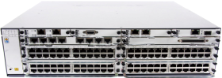









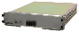

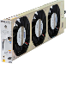


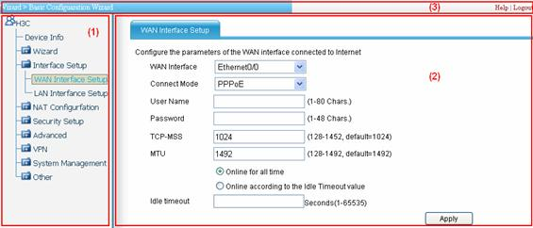

AR Routers: Key Selling Points
Most Comprehensive Service Functions
Routing
Routing switching: Abundant access and uplink interfaces (Eth/SA/E1/FXS/PON/LTE, etc.), high-density switching access (24GE/51GE)
VPN: IPsec VPN/DSVPN/Any-to-Any VPN/MPLS VPN/L2TPv3
Security: IPS/Firewall/URL filtering
Wireless: Wireless 3G/4G uplink, Fat and Fit APs, built-in AC
Voice: Voice gateway, enriched enterprise PBX voice services
Integrated 6 key techniques
Switching
Voice
AR
VPN
Security
Wireless
Dual SRUs
Nonstop forwarding
Most Reliable Router
Industry Data
Device-level reliability: Dual SRUs, hot swapping, NSF/GR, redundancy of fan and power modules
Network-level reliability: Link backup and load balancing, smart policy routing, association between BFD and NQA
Service-level reliability: Security defense, application visibility and control
VoIP
eSight
W A N
OA
Video
Application inspection
Guest
Mail
Hot swapping of full series of cards
Redundancy design of key components
Hardware QoS
Device-level reliability
Network-level reliability
Service-level reliability
Most Convenient Management
Zero-touch configuration: Supports TR069 and works with the ACS and NMS, making network O&M simpler.
Batch deployment using the USB flash drive: Requires no specialized training.
Web-based NMS, GUI-based O&M: Better user experience with GUI-based operations and maintenance
Zero-touch
configuration
Easier O&M
USB flash drive
Web-based NMS

Slide 32





AR IoT Gateways: Key Selling Points
Most Complete Access Types
Abundant interfaces: 17+ types of interfaces, such as industrial serial interfaces, PLC, RS485/RS232, Wi-Fi and interfaces.
Reliable and flexible remote access in the industrial field
Various industrial interfaces, facilitating stable transition of networks
IoT Gateway
Strongest Environment Adaptation
Operating range: –40℃ to +70℃
Resist electromagnetic interference
Fan-less convection cooling
IP54 ingress protection
Substation compliant
Edge Computing Gateway
Highest Intelligence
Most Convenient Management
^{APP1}
Container
Built-in containers: Rapid deployment of customized industry apps
Open architecture with standard eSDK&API: Rapid integration with partners' applications
Converged management: Terminals, gateways, computing, applications, and data
Batch deployment using the USB flash drive
VRP
…
^{APPn}
eSDK
DI/DO
RS485
RS232
RF
…
Linux Kernel

Slide 33
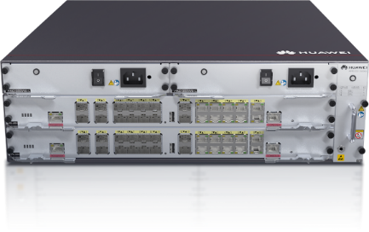
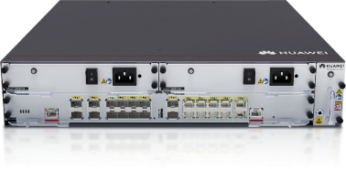
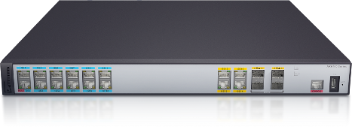
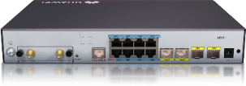
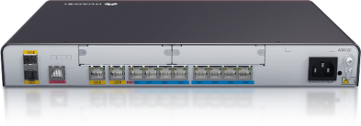
Huawei Next-Generation NetEngine AR Branch Routers
NetEngine
AR651
NetEngine
AR6121
NetEngine
AR6140
NetEngine
AR6280
NetEngine
AR6300
(Small branch)
(Small/Midsize branch)
(Midsize branch)
(Midsize/Large branch)
(HQ/Large branch)
High density, all-GE
2Gbps
10GE uplinks & multi-service
2Gbps
High performance, extensive interfaces
2Gbps~6Gbps
High performance, extensive interfaces
10Gbps~12Gbps
3x SD-WAN performance
10Gbps~12Gbps
High performance
3x performance, all series ready for SD-WAN network evolution in the next 5 years
Hyper convergence
Simplified network deployment with fewer branch devices required
Simplified O&M
Deployment in minutes through ZTP, web-based O&M
In-house design and controllability
In-house design for full series, controllable and trustworthy components

Slide 34
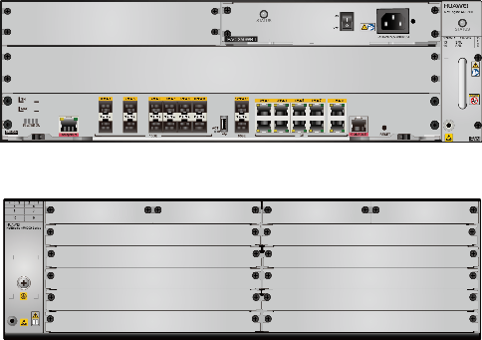










Huawei NetEngine AR Series Routers
HQ/Large branch
NetEngine AR6300
NetEngine AR6280
NetEngine AR6300/AR6200 series
SRU-400H/SRU-600H
SRU-400H/SRU-600H
Branches of small and midsize enterprises
NetEngine AR6121
NetEngine AR6140-9G-2AC
NetEngine
AR6100 series
Small enterprise
Ethernet + LTE (MIC)
Ethernet + Wi-Fi + LTE (MIC)
Ethernet + DSL + Wi-Fi + LTE (MIC)
NetEngine
AR650 series
AR651
AR651W
AR657W
SOHO
Ethernet + Wi-Fi
Ethernet + Wi-Fi + voice
Ethernet + Wi-Fi + LTE + Voice
NetEngine
AR610 series
NetEngine AR611W
NetEngine AR617VW
NetEngine AR617VW
-LTE4EA

Slide 35
NetEngine AR and AR G3 Mapping
Category | AR G3 | NetEngine AR
AR modular routers | AR3260 | AR6300 + SRU400-H/600-H
 | AR2240/AR2240C | AR6280 + SRU400-H/600-H
 | AR2220E | AR6140-9G-2AC
 | AR2204E/AR2204-27GE/27GE-P | The AR2204 can be delivered.
 | AR2204-51GE/51GE-P
 | AR1220E/AR1220/AR1220C | AR6121
AR fixed-configuration router | AR161/AR161F | AR651
 | AR161G-L/AR161FG-L | AR651
 | AR161EW | AR651W
 | AR169EW/AR169EGW-L | AR657W
 | AR109/AR109W/AR129CV/AR129CVW/AR169/AR169W/AR169F/AR169FVW | AR617VW
 | AR109G-L/AR129CGVW-L/AR169G-L/AR169FGW-L | AR617VW-LTE4EA
 | AR161W/AR161FW | AR611W

Slide 36












Mapping Between Huawei's Next-Generation NetEngine AR Series Routers and Cisco ISR Series Routers
AR6300 (3U, 12 Gbps)
Huawei
AR6280 (2U, 10 to 12 Gbps)
AR6140 (1U, 2 Gbps)
ISR 4461
AR650 (Box, 1 to 2 Gbps)
AR6121 (1U, 2 Gbps)
ISR 4451-X
AR610 (Box, 300 Mbps)
ISR 4431
ISR 4351
ISR 4321
ISR 4331
Cisco
ISR 1100-8P
ISR 4221
ISR 900
ISR 1100-4P
ISR 800

Slide 37
IP Products Sales Strategy Overview
Campus Switches
Campus WLAN Products
Data Center Switches
Edge Routing: AR G3 Products
Core Routing: NE Products
Security Products

Slide 38



NE Router Sales Opportunities & Strategies
Opportunities
ISP
Government
Energy
Transportation
OTT: OTT DCI network
IP Metro
IAP: BRAS
Leased lines
Bandwidth rental
National broadband
Traditional backbone
e-Government
Safe city
Education backbone NREN
IP MPLS transmission and transformation network
Oil and gas pipeline
GSM-R
Railway LTE-M
DCS
Strategies
Focus on cloud network and network digital transformation in developed countries.
Focus on construction of infrastructure like national broadband and e-government in developing countries.
OTT players speed up construction in markets outside China. Cloud backbone solutions focus on accelerating provisioning, optimizing bandwidth, and simplifying protocols.
In MAN, NE routers have high reliability, large bandwidth, and high performance.
For IAP, mini-BRAS can be deployed with OLT, saving space and providing large table size for more subscribers.
For electric power and transportation, focus on SDH/EoS, OT/IT network digital transformation, easy O&M, IP hard pipe for critical services, and 50 ms protection switchover.

Slide 39









Key Selling Points of NE Routers
High-Speed and Reliability Network
Industry largest capacity (14.4T/slot @ NE8000-X series)
1st 1T NP Chip and 1st 400GE Commercial solution
99.999% high availability, with 50 ms protection switchover
IP hard pipe in support for SDH-like O&M and SLAs to carry key services
100G/200G/400G
DC
DC
backbone interconnection
Simple architecture
Built-in PCM, 64K to 100GE any service access,
Innovative IP hard pipe Converge OT and IT Network ，Simplifyconvergence
SR/EVPN unified pipe encapsulation, simplifying protocols
Support for the industry's first 400GE ports, simplifying topology
10G
40G/100G
converged bearer
Easy O&M
Minute-level service provisioning and on-demand bandwidth adjustment supported by the NCE-IP
Telemetry-based data collection within milliseconds, with clear network insights
Real-time flow-based iFIT, accurate service insights, and quick troubleshooting
integrated access

Slide 40



New Requirements at Cloud Era on IP Networks
Immersive experience services
Vertical industries
Site-to-cloud private lines
10x
higher bandwidth
SLA
assurance
Automated
one-hop to the cloud
LG U+ (South Korea): 8K VR games b/w
>200Mbps
CCTV New Year's Gala 2019 (China): 4K live broadcast b/w 40Mbps~90Mbps
China Southern Power Grid: Latency for differential protection: 5ms~10ms
China Mobile (Zhejiang): Latency for remote medical rescue: 15ms~20ms
China Unicom (Guangdong): site-to-cloud private line services provisioned within 2 days and real-time bandwidth adjustment through app-based self service

Slide 41











Huawei NetEngine Router Family Portfolio
Core Router
NetEngine 8000 X8/X4
NetEngine 9000-8/20
NetEngine 40E X16A/X8A
4T line card, 80T/chassis
Cable-based Backplane, up to 8T/slot
2T line card, BNG/FMC Service Router
4T line card, Scale to 14.4T/slot
Compact Design
Aggregation Router
NetEngine 8000 M14
NetEngine 8000 M8
5U, 2T, Scale to 4.8T
300mm depth
3U, 1.2T
300mm depth
Access Router
NetEngine 8000 F1A
NetEngine 8000 M1A
NetEngine 8000 M6
1U
dual AC/DC
1U, 220mm depth
DC: 1+1 redundancy
2U, 220mm depth
DC/AC: 1+1

Slide 42
NE Router Mapping Table
Old Model
New Model
V1R19C00 | V1R19C10
 | 
 | 
 | 
 | 
 | 
 | 
 | 
 | 
Core Router
NE9000-20/8
New NE9000-20/8
NE40E-X8A/16A
NE40E-X8A/16A (2T)
NE8000-X4/8
Aggregation Router
NE40E-X3/X8/16
NE20E-S16/16A
NE20E-S8/S8A
NE8000-M14
NE40E-M2K/M2K-B
NE20E-S2E
NE20E-S2F
NE8000-M8
NE20E-S4
NE08E-S9
Access Router
NE08E-S6E
NE8000-M6
NE40E-F1A
NE05E-SQ
NE8000-F1A
NE05E-SR
NE05E-SJ/SK
NE8000-M1A
NE05E-SL
NE05E-SM
Notes:
修改

Slide 43
IP Products Sales Strategy Overview
Campus Switches
Campus WLAN Products
Data Center Switches
Edge Routing: AR G3 Products
Core Routing: NE Products
Security Products

Slide 44





Security Product Sales Opportunities & Strategies
NGFW for carrier resale and NA
Proposal: Firewall solution to guarantee the L7 security for branches with leased Ethernet lines
Industry: Public sector, government, large enterprise,
and education
Security of datacenter network
Proposal: Deploy DC firewall and security controller：provide IPSEC VPN, virtualization、SDN、Secure Resource Pool Solution
Industry: Finance, energy, large enterprise, government
Opportunities
DDoS prevention for ISPs and data centers
Proposal: Data center and ISP infrastructure security solutions to prevent DDoS attacks and ensure system operating; anti-DDoS operation platform solution
Industry: Public or private cloud data center, ISP
Security of campus networks
Proposal: Deployment of firewalls, professional security hardware gateway, secure terminal access, and unified policy management software to realize comprehensive threat protection
Industry: Large enterprise, public sector, education
Focus on the carrier resale SMB market and NA expansion，involving the public sector, banks, and large enterprises, and provide the routing, switching, security, and L7 application analysis services using USG series NGFWs.
Focus on ISPs and data center NAs, and introduce the Huawei solution with anti-DDoS capability, high capacity, high response speed, and highly accurate detection.
Strategies

Slide 45






Key Selling Points of Security Products
To find more opportunities from ISP, bank DC, and online gaming projects, and win back Radware and Arbor users.
To engage more managed security service providers (MSSPs), and discuss what we can do for them with the competitive products. We can also consider a new cooperation business model beyond selling devices.
Draw up a marketing plan such as participating in local forums and summits to get involved.
ISPs
Gov./Edu./
Enterprise
Banks
Anti-DDoS
DC
DC
Branches
Campus
DC
Branches
Focus on education institutes, banks, and government branches which require a large number of firewalls used as access gateways with AV/IPS/URL features only.
Work with campus in projects to win more customers and improve the brand of Huawei security. Also, find product weaknesses and make products better.
Try to find distributors, conduct in-depth talk with them about advantages and disadvantage of Huawei firewalls, and discuss how to win sales opportunities in Fortinet-involved projects. We can provide customized features to build the leading business for customers.
Oil
Electric power
Manufacturing
NGFW
Campus
DC

Slide 46






HiSec: Intelligent Security Protects a Fully Connected, Digital World
Intelligent detection
99%
Safe City
e-Government Cloud
Telecom Cloud
Unknown threat detection accuracy
...
Scientific research enterprises
Manufacturers
Government security brain
Industrial park
Threat intelligence
Intelligent handling
Second-level
Analyzer
Threat response time
CIS
FireHunter
Network and security device collaboration, proactive threat deception, and automatic closed-loop handling
Controller
Identity controller
Intelligent O&M
80%
SecoManager
iMaster NCE
IAM
Enforcer
OPEX
Security O&M costs
ICT infrastructures
Based on automatic mapping from services to policies

Slide 47











Huawei Security Products Family 2020 H1
High Security
Data Center
NGFW
Anti-DDoS
Chassis High-end
20Gbps
40G~2Tbps
Sandbox (Firehunter6000）
Management
USG9500
AntiDDoS1825
AntiDDoS8000
HiSec Insight (CIS)
NGFW
Campus & Branch
Branch
Branch/ Small Campus
Large Campus/ Small DC
1-4G Desktop
2~8Gbp,1U
10~40Gbps, 1U
2*40GE(QSFP+)+ 12*10GE(SFP+) + 16*GE RJ45
USG6530E: 2*10GE/GE+10GE
USG6635E / 6655E
SecoManager
USG6510E: 2GE(SFP)+10GE
6*10GE(SFP+)+6*GE(SFP)+16*GE
2*10GE(SFP+)+ 8*GE(Combo)
USG6510E/6530E
USG6525E /6555E/6565E/6585E
USG6615E / 6625E

Slide 48












Huawei NGFW GTM Strategy in 2020
License
USG12008, 2.4Tbps,15.8U, 40GE,100GE
2020.Q4 GA
Performance expansion license 20Gbps for USG9500/USG12000
Vsys (Virtual firewall) license, 10 Vsys for free, expansion quantity by 5~4000
SSL VPN concurrent users, 100 users for free, expansion quantity by 100~20000
Years of threat protection service, include IPS/AV/URL filtering/cloud sandbox
USG9580, 1.92Tbps,32U, 40GE,100GE
USG12004, 600Gbps, 9.8U, 40GE,100GE
USG9560, 960Gbps, 14U, 40GE,100GE
USG6716E, 160Gbps, 1U, 2*100GE+2*40GE+20*10GE+2*10GE HA
USG9520, 120Gbps, 4/5U, 40GE,100GE
USG6712E, 120Gbps, 1U, 2*100GE+2*40GE+20*10GE+2*10GE HA
USG6680E, 80Gbps, 1U, 4*40GE+28*10GE+2*10GE HA
USG6655E, 40Gbps, 1U, 2*40GE+12*10GE+16*GE(RJ45)
USG6635E, 20Gbps, 1U, 2*40GE+12*10GE+16*GE(RJ45)
USG6625E, 20Gbps, 1U, 6*10GE+6*GE(SFP)+16*GE(RJ45)
USG6615E, 12Gbps, 1U, 6*10GE+6*GE(SFP)+16*GE(RJ45)
USG6585E, 9Gbps,1U, 2*10GE+8*GE Combo +2*GE WAN
USG6565E, 6Gbps,1U, 2*10GE+8*GE Combo +2*GE WAN
USG6555E, 4Gbps,1U, 2*10GE+8*GE Combo +2*GE WAN
USG6525E, 2Gbps,1U, 2*10GE+8*GE Combo +2*GE WAN
USG6530E, 4Gbps, Desktop, 4GE+2Combo, 2*10GE+10*GE(RJ45)
USG6510E, 1.2Gbps, Desktop, 2*GE(SFP)+10*GE(RJ45)
USG6510E-POE, 1.2Gbps, Desktop, 2*GE(SFP)+10*GE(RJ45), GE0/0/0-GE0/0/3 support PoE

